Slide 1


Predicting Airbnb Rental Property Return On Investment
Mohammad Bakir
Notes:
Good morning everyone, my name is Mohammad Bakir and I am here today to talk about my Airbnb Rental Property Return on Investment Predictive Model

Slide 2
Problem Statement & Motivation
Develop a linear regression model that can Predict Return on Investment (ROI) of a Rental Property Offered on Airbnb.
Make Smarter Real Estate Investment Decisions:
Analyze Markets, drilling into Neighborhoods, and by determining from the over 20 Property Features and signals which are the most influential in increasing investment value anywhere on the Airbnb network.
Notes:
Everyone in here today will hopefully one day become a real estate investor or is already one.. My model analyzes Market and Neighborhood Data, and Determine from over 20 property features and signals which are most influential in increasing investment value anywhere in the Airbnb Network

Slide 3
Process Pipeline
Data Collection and Pre-Processing
EDA / Feature Transformations
Model Training / Validation
Deployment
Notes:
My approach to this product is as follows, I first collected data for San Francisco to establish a baseline Proof of concept from the following reputable resources.

Slide 4



Data Collection – By SF Neighborhood
Zillow
Redfin
Airbnb
Home Value Index
Rent Value Index
Median Sale Price
Walkability Score
Transit Score
Bike Score
Bed/Bath Count
Accommodations
Listing Scores
Amenities
Monthly Rent Price
Data Period: 01/2018 – 01/2019
Property Type: 1 to 4 Bedroom Apartment, House, Condominium, or Townhouse
Neighborhood Count: 39
Tools Used
Notes:
Zillow for Property Value and Rental Metrics
Redfin for Neighborhood Accessibility Scores
Airbnb for Property Metrics
My focus was on properties that are an Apartments, Houses, Condominiums, Townhomes, with a minimum of 1 bedroom and maximum of 4 bedrooms.

Slide 5
Data Cleaning
Adjusted Mismatched Neighborhood Names
e.g.: Ocean View Ocean View Terrace
Presidio Presidio Heights
Dropped Unused Features
e.g.: Host Name, Listing Id, Lat Long Geo System
Merged Data From The Different Resources
Generated Return On Investment (ROI) Target Values
Notes:
After collecting my data, I cleaned the data by adjusting the mismatch neighborhood names from the various resources, dropped unused features that I felt were irrelevant to my case.
As ROI data is not readily availably, I calculated my ROI values as follows,

Slide 6
ROI % =
(Sum of Annual Return / Sum of Total Investment)
* 100
Notes:
ROI% = Sum of Annual Return / Sum of Total Investment * 100
All features utilized to calculate my ROI were dropped from my modeling.

Slide 7
Process Pipeline
Data Collection and Pre-Processing
EDA / Feature Transformations
Model Training / Validation
Deployment
Notes:
After collecting my data I performed initial exploratory data analysis to help guide me in my feature transformation process.

Slide 8
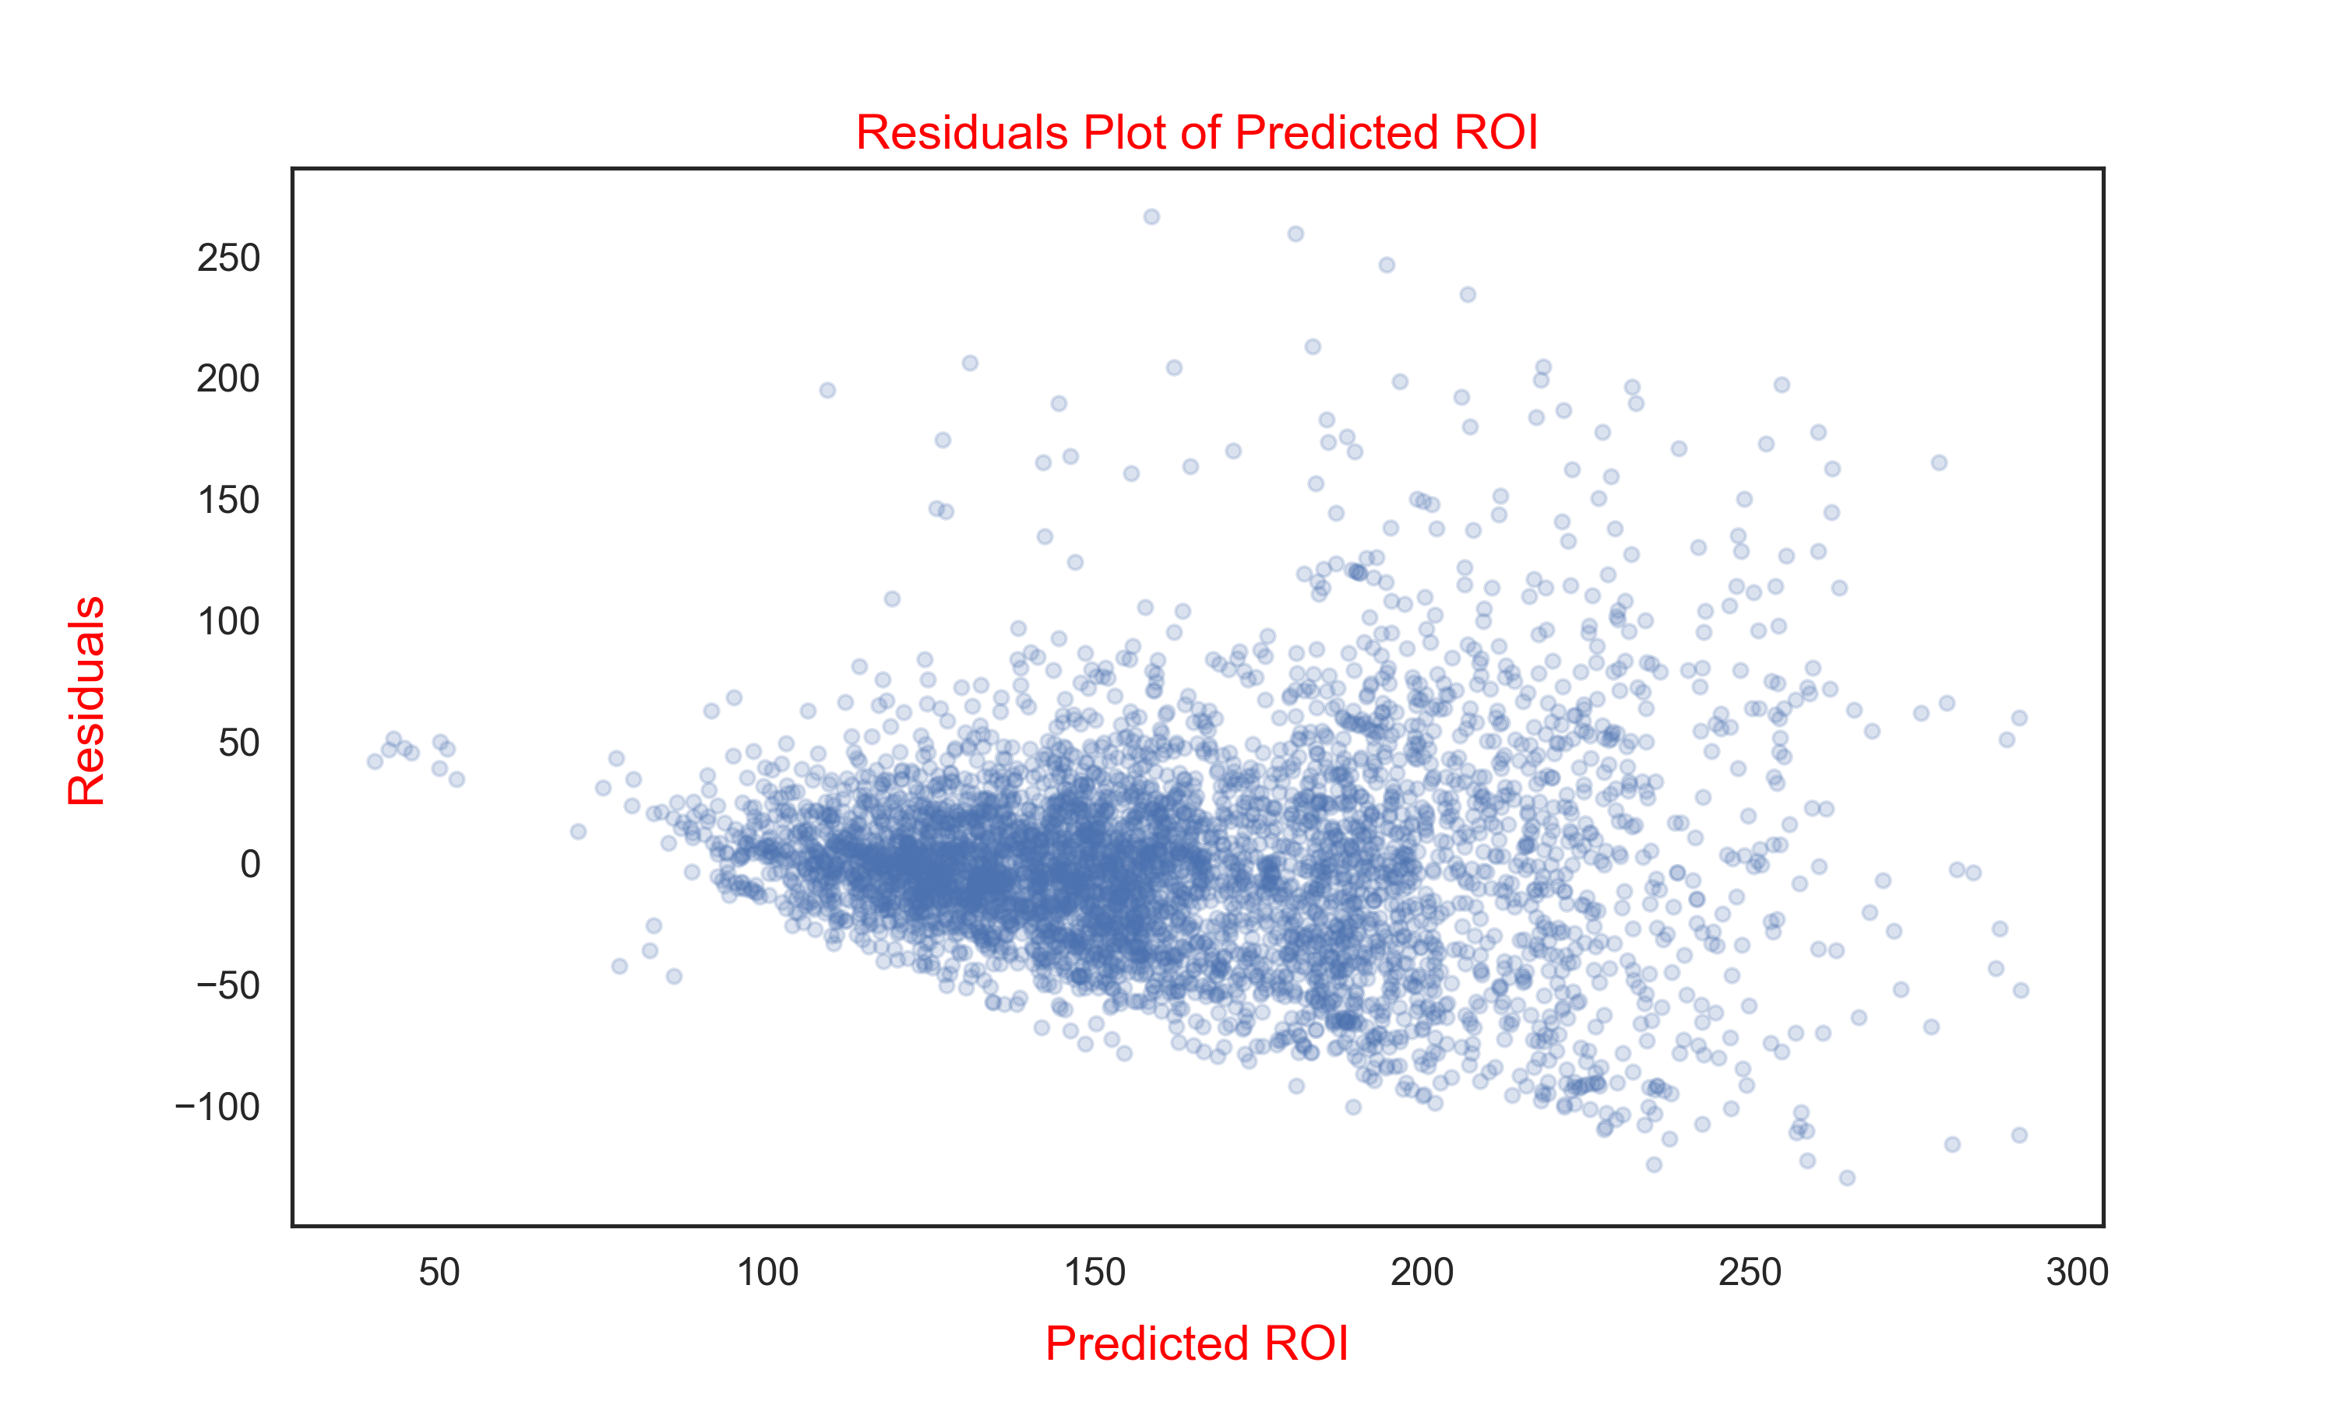
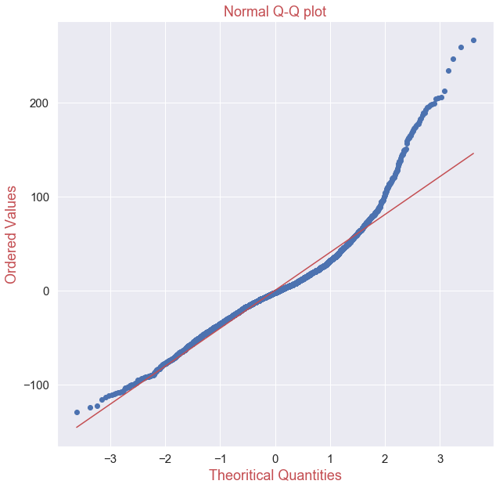
Data Considerations
Notes:
I developed a Residual Plot to help my determine how symmetric my model is when predicting ROI. From the graph on the left my data appears to show Heteroskedasticity in which my base line model makes systematic errors when making large ROI predictions, ideally we should see clustering around y = 0 with constant variance across data.
I graphed a q-q plot to help me determine if my data plausibly came from a normal distribution, bending in my tail indicating Some Right Skewness in Data.

Slide 9
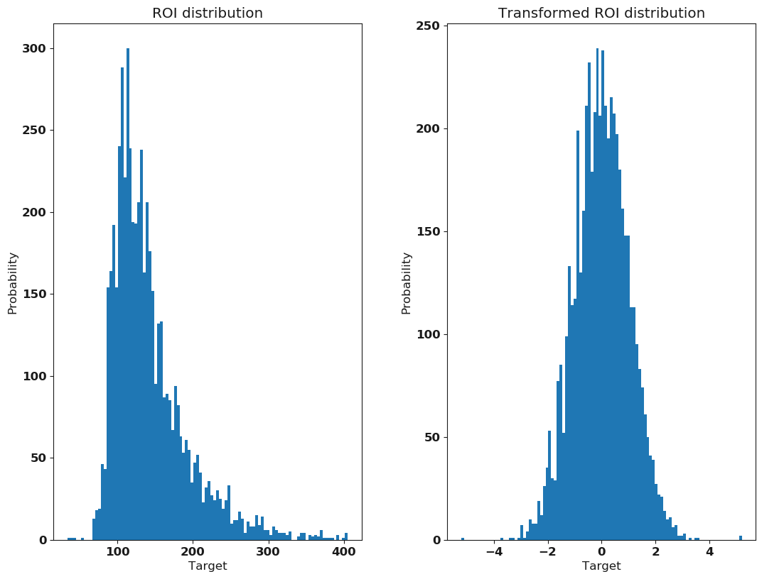
Feature Transformation
Normalizing Data
- Log Transform
- Q Transform
- Box Cox Transform
One Hot Encoding
- Categorical Value
Representation
Text Analysis
- Categorized Amenities
Basic
Dining
Facilities
Notes:
Q Transform is a method that transform features to follow a uniform or a normal distribution, fulfilling one of the assumptions of linear modeling.

Slide 10
Process Pipeline
Data Collection and Pre-Processing
EDA / Feature Transformations
Model Training / Validation
Deployment
Notes:
After transforming my data I began my base line model training

Slide 11
Base Line Model – OLS Regression
Untransformed Features/Predictor
Adj R-Squared : 0.397
Transformed Features/Predictor
Adj R-Squared : 0.473
Notes:
Early Least Squared Models without Transformations show a lower R Squared value. Meaning more variance in my measurement. When I transformed my data, my OLS R squared value increase significantly indicating there is strong correlation between my features and ROI.

Slide 12
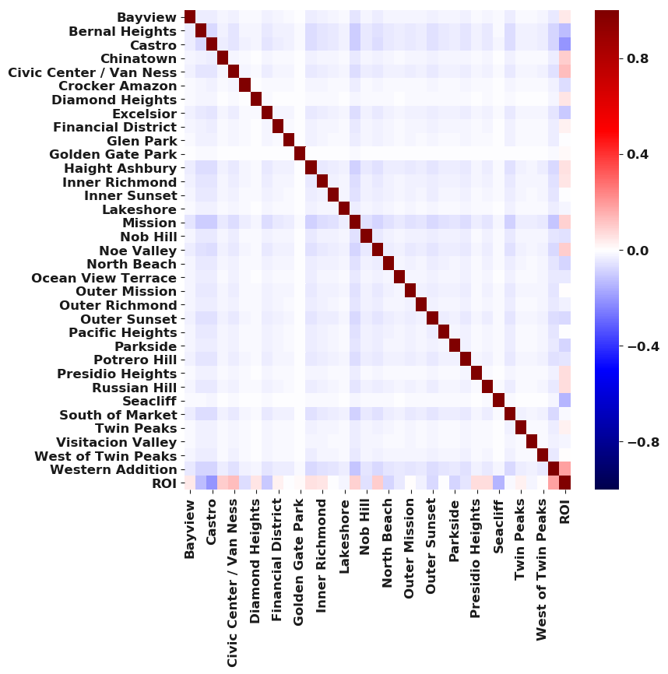
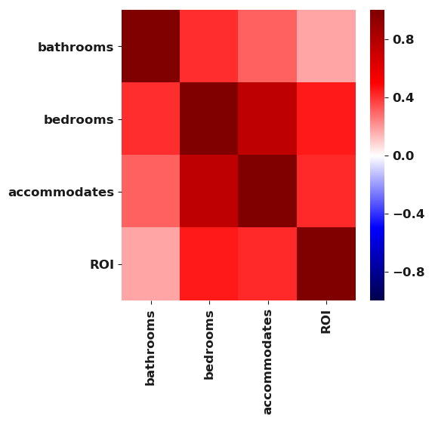
Transformed Features/Predictor

Slide 13
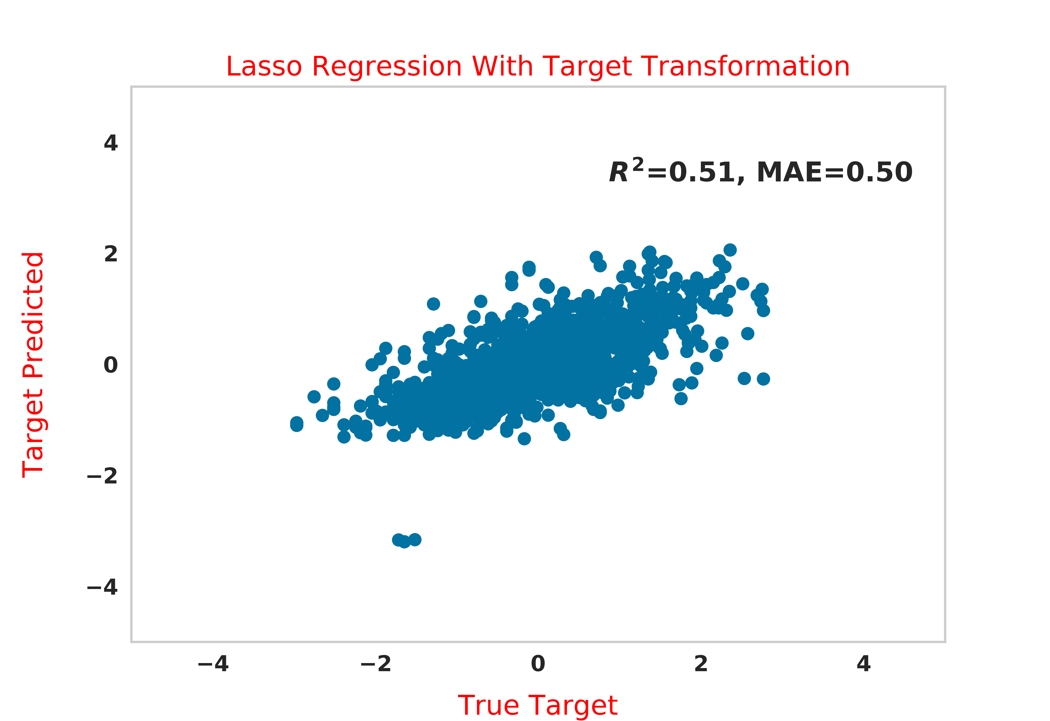
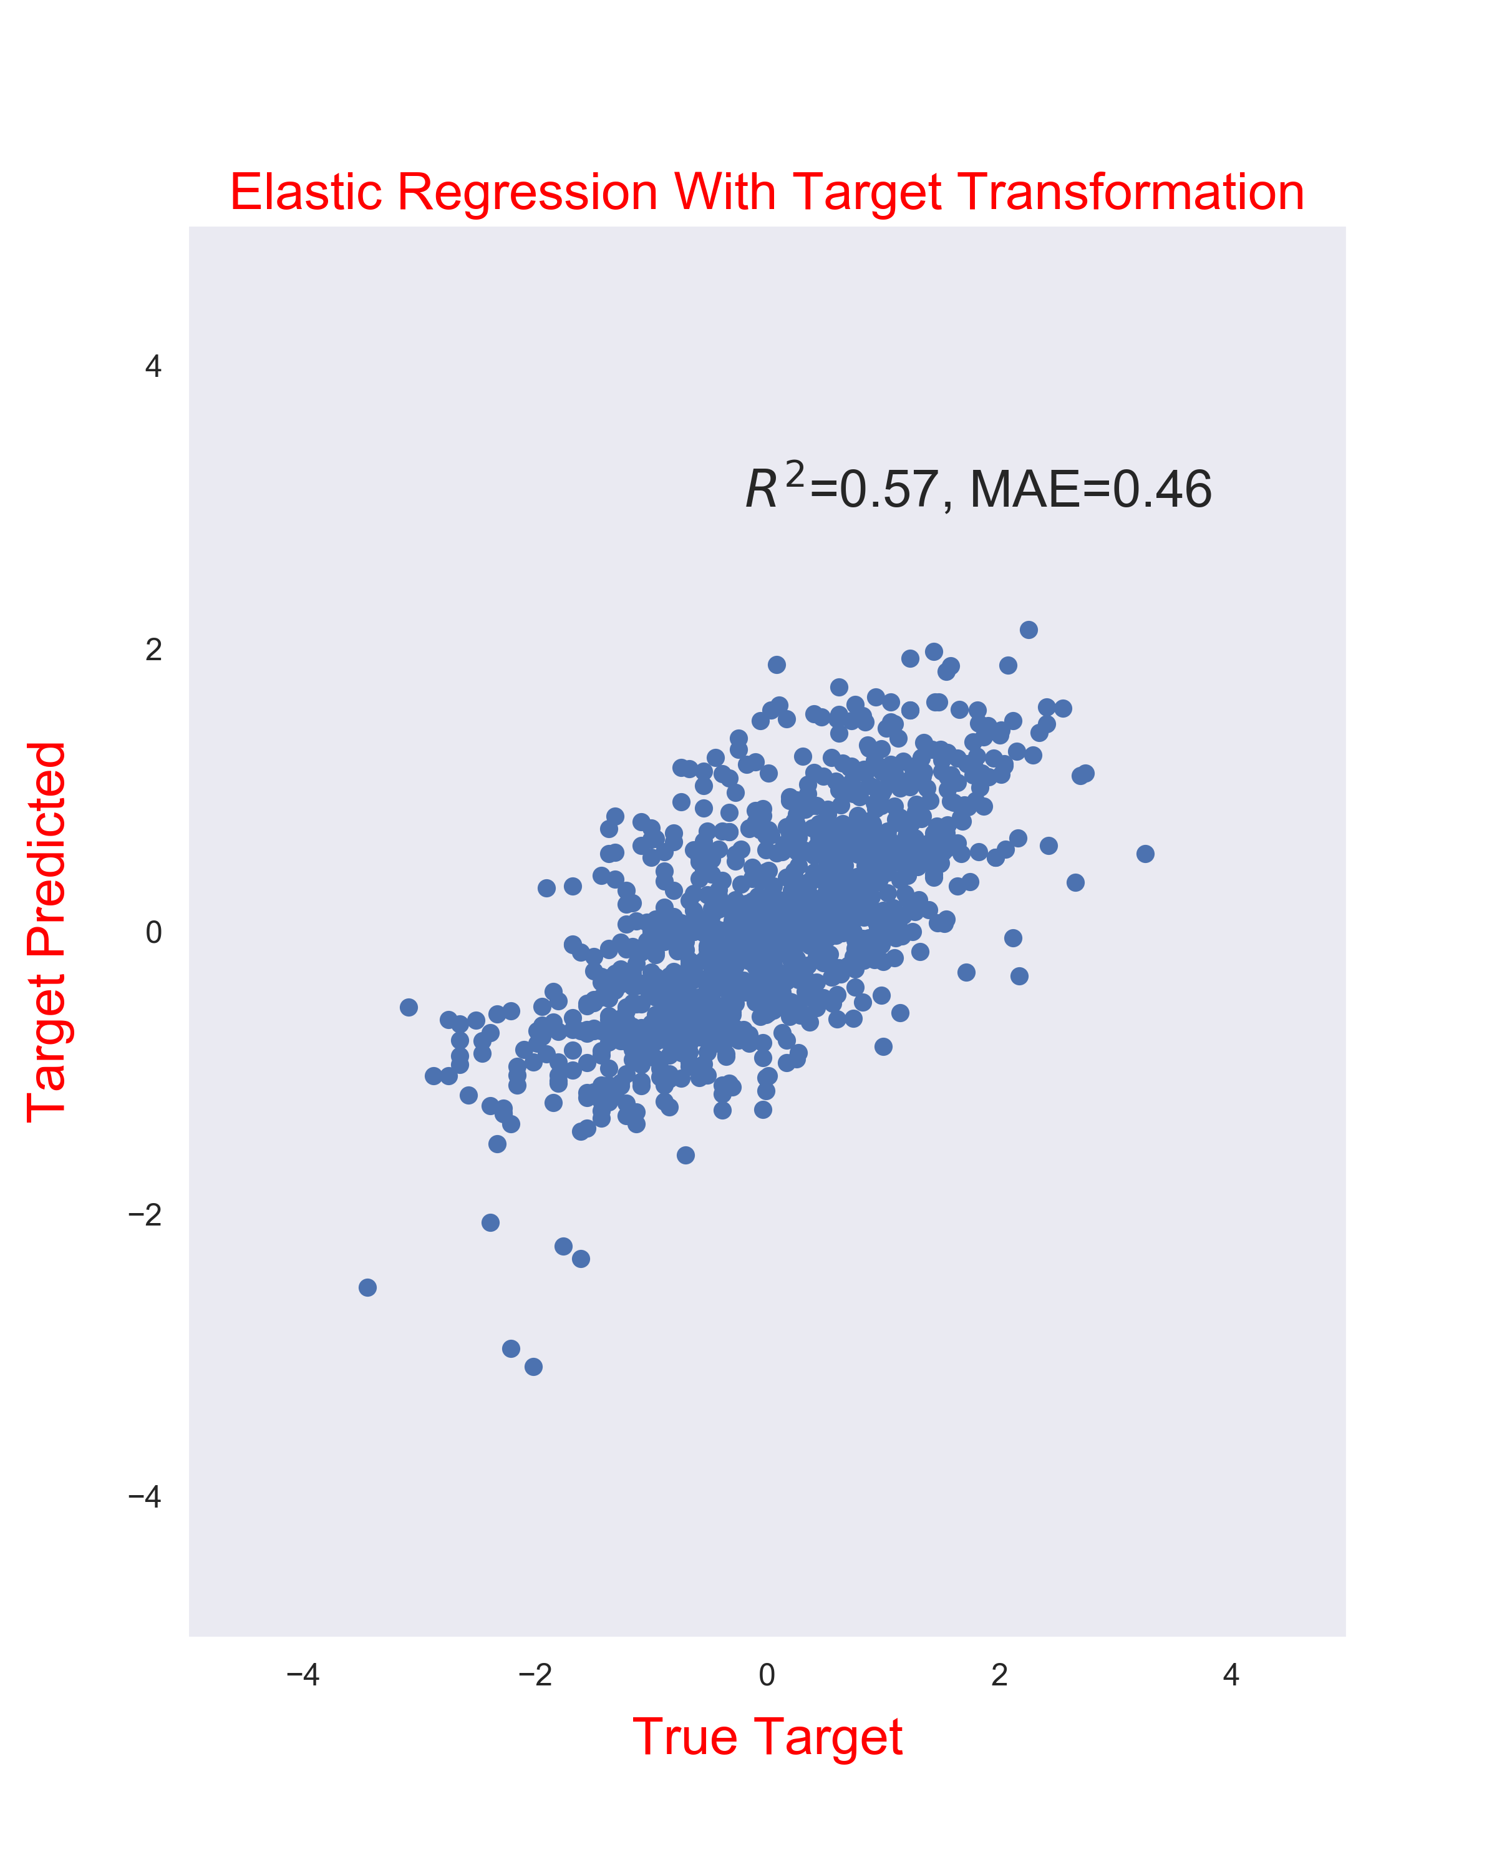
Lasso / Elastic Regression Grid Search With Cross Validation
Notes:
I wanted to analyze if other models could out perform my OLS model. I Fit my data using Lasso and Elastic Regularization. I determine my training hyperparameters utilizing grid search cross validation, , my lasso performed better than my OLS models, however as I expected my Elastic Regression performed better as it assisted my model in becoming more generalized.
Cross-validation is primarily used in applied machine learning to estimate the skill of a machine learning model on unseen data.
Grid search is the process of performing hyper parameter tuning in order to determine the optimal values for a given model. This is significant as the performance of the entire model is based on the hyper parameter values specified.

Slide 14
Process Pipeline
Data Collection and Pre-Processing
EDA / Feature Transformations
Model Training / Validation
Deployment

Slide 15
Most Important Features
Results
Model Performance Metrics
Adjusted R² = 0.57
Mean Absolute Error = 0.46
Greatest Predictors of ROI:
Neighborhood Locations
Number of Bedrooms
Accommodations Count
Feature | ROI Effect
Chinatown | 0.98
Civic Center / Van Ness | 0.94
Diamond Heights | 0.94
Western Addition | 0.56
Bayview | 0.50
Financial District | 0.41
Presidio Heights | 0.36
Number of Bedrooms | 0.31
Accommodations Count | 0.27
Russian Hill | 0.21
Notes:
MAE -> Measures Average Magnitude of the errors in a set of predictions without considering their direction. The average over the test sample between predicted and actual observations
Taking the square root of the average squared errors has some interesting implications for RMSE. Since the errors are squared before they are averaged, the RMSE gives a relatively high weight to large errors. This means the RMSE should be more useful when large errors are particularly undesirable.
RMSE has the benefit of penalizing large errors more so can be more appropriate in some cases

Slide 16
Future Work
Collect ROI Data
Collect Additional Property Data
Consider Real Estate Market Trends
Utilize Non-linear model on the Dataset
Analyze Other Markets

Slide 17
QUESTIONS?

Slide 18
Appendix

Slide 19
ROI Calculation
ROI Calculated For A Single Year Based On The Following
(Annual Return)
Airbnb Property Yearly Rental Rate
San Francisco Real Estate Appreciation Rate of 6.83%
(Total Investment)
All Cash Purchase
Closing Costs Calculated at 3.5% of Median Home Sale Price
Imposed 1% Yearly Maintenance Rule On Median Home Value
Yearly Insurance and Tax at Approx. 2% of Median Home Value
ROI % =
(Sum of Annual Return / Sum of Total Investment) * 100

Slide 20
Amenities
Basic | Dining | Facilities
WiFi | Kitchen | Parking
TV | Dishwasher | Backyard / Garden
Fireplace | Coffee Maker | Porch
Iron | Microwave | Tub
Towels | Refrigerator | Jacuzzi
Bedding | Oven | Pool
Heater | Stove | BBQ
Air Conditioning | Dishes | Safety
Washer | Silverware | Garage
Dryer | N/A | Kid Safe

